Slide 1
J2EE与中间件技术
——Lab

Slide 2
JBoss的下载、安装
1、下载JBoss服务器，WildFly即Jboss8
  http://wildfly.org/downloads/
    Wildfly-15.0.0.Final
  或JBoss7
  http://jbossas.jboss.org/downloads
    jboss-as-7.1.1.Final
  注：不需要下载jbossEAP(Enterprise Application Platform)版本
2、解压缩

Slide 3
JBoss + Eclipse
在Eclipse中，需要安装JBossAS tools
否则，Server中无法选择到JBoss Server

Slide 4
Install the most recent JBoss tools
search for "JBoss Tools (2018-09)" in Eclipse via:
Help > Eclipse Marketplace...
JBoss Tools 4.9.0Final
  选择Jboss … Widlfly …
Next, etc, Finish.

Slide 5
在Eclipse中配置JBoss服务器
启动Eclipse →Windows →Show view →Other
  选择Server文件夹下的Servers
Servers 单击鼠标右键
  new →Server
  选择WildFly 1x.x或 JBoss V7.1 →Installed Runtimes
    注：安装JBoss Tools后，才可以选择到Jboss Server
  JRE->jre9 或 jre7
    注： JBoss V7.1 只支持jre7
  其他默认

Slide 6
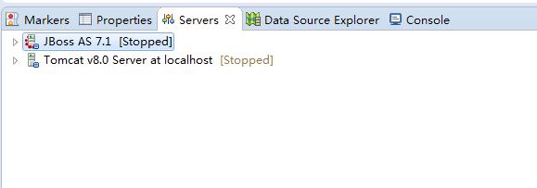
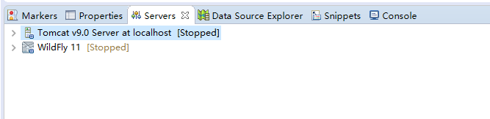

Slide 7
Create an EJB project
File->New->EJB project
  Project Name: HelloWorldEJB
  Target runtime->Jboss v7.1或 WildFly 1x.x
Finish

Slide 8
New Session Bean
Project Explorer-> HelloWorldEJB ->EJBModule -> new->package
  edu.nju.session.stateless
New->Session Bean(EJB 3.x)
  StateType: Stateless
  Class Name: HelloWorldBean
  Remote:√(HelloWorld)

Slide 9
Server
Server->Add and Remove…-> Add HelloWorldEJB
Start
控制台：
……Starting deployment of "HelloWorldEJB.jar"
…… JNDI bindings for session bean named HelloWorldBean in deployment unit deployment "HelloWorldEJB.jar" are as follows:
  java:global/HelloWorldEJB/HelloWorldBean!edu.nju.session.stateless.HelloWorld
  java:app/HelloWorldEJB/HelloWorldBean!edu.nju.session.stateless.HelloWorld
  java:module/HelloWorldBean!edu.nju.session.stateless.HelloWorld
  java:jboss/exported/HelloWorldEJB/HelloWorldBean!edu.nju.session.stateless.HelloWorld
  java:global/HelloWorldEJB/HelloWorldBean
  java:app/HelloWorldEJB/HelloWorldBean
  java:module/HelloWorldBean
……

Slide 10
Create an Application Client project
File->New-> Application Client project
  Project Name: EJBClient
  Target runtime->Jboss v7.1 或 WildFly 1x.x
Finish

Slide 11
New remote client
将EJB接口复制到此工程内；
Project Explorer-> EJBClient>appClientModule -> new->package
  edu.nju.session.client
New->class
  Class Name: HelloWorldClient

Slide 12
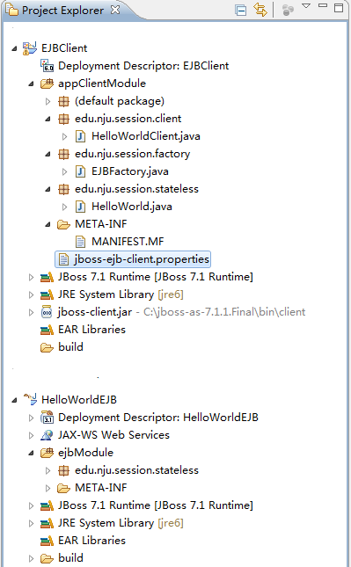
加入jboss-client.jar
注：JNDI Remote Client需要的JAR包
Project Explorer->Configure Build Path-> Add External JARs-><jboss安装目录>\bin\client\jboss-client.jar

Slide 13
创建properties文件
注：JNDI Remote EJB Client需要的properties
在类路径下创建文件
  jboss-ejb-client.properties

Slide 14
jboss-ejb-client.properties
Jboss v7.1
  remote连接端口号 4447
WildFly 1x.x
  remote连接端口号 8080
……
remote.connection.default.port=4447 或 8080
……

Slide 15

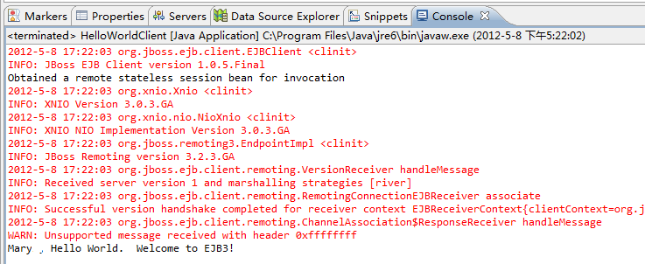
运行HelloWorldClient

Slide 16
Junit测试
EJBFactory.java
  使用JNDI获取EJB对象
HelloWorldTest.java
  Junit测试类

Slide 17
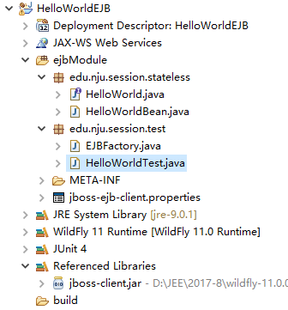
配置同Client
1：JNDI Remote Client需要的JAR包
2: JNDI Remote EJB Client需要的properties

